Slide 1


WeatherOrNot
Weather Application
By: Alvaro and Ben

Slide 2



Introduction
Intro
Methodology
Architecture
Demo
Challenges and Improvements
Whether it is ready or not, whether you wanna hear it or not, whether it is good or not. We present you WeatherOrNot

Slide 3



Table of contents
01
02
Methodology
Architecture
03
04
Demo
Challenges and Improvements

Slide 4

01
Methodology

Slide 5

What we used
Intro
Methodology
Architecture
Demo
Challenges and Improvements
Frontend
React
Tracks location
Displays fetched data
Handles data functions
Backend
Flask
Waits for call
Fetches data
Database
PostgreSQL
Weather API
Styling
CSS

Slide 6
Concepts Implemented
Intro
Methodology
Architecture
Demo
Challenges and Improvements
Save/delete locations (PostgreSQL)
Locations can be viewed again
Live forecast (WeatherAPI.com)
Displays temperature, humidity, wind speed, and an insight
Search by city/zip
Ability to search either city or zip using regex
To-do list
Shows weather for given day of activity

Slide 7
02
Architecture

Slide 8

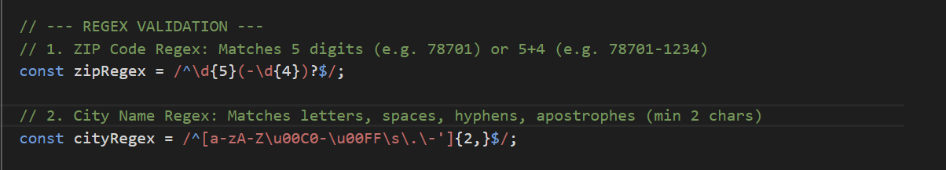
Front-End
Intro
Methodology
Architecture
Demo
Challenges and Improvements
Regex
Responsible for making sure a city or zip code is correct
If less than 1 char it will give an error
It allows autofill if there are 2 char or more
LocationsPanel.jsx
\d -> digits
a-zA-Z ->
u00C0-\u00FF -> accents
\s -> space
\. -> dot
\- -> Hyphen
’ -> Apostrophes

Slide 9
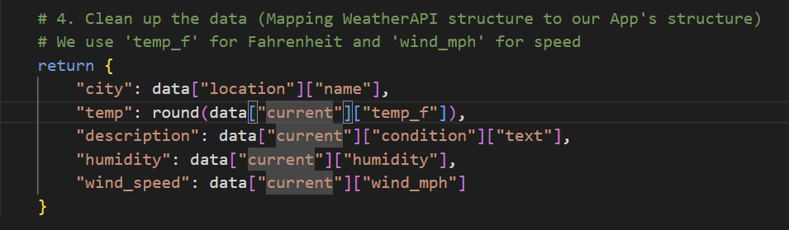
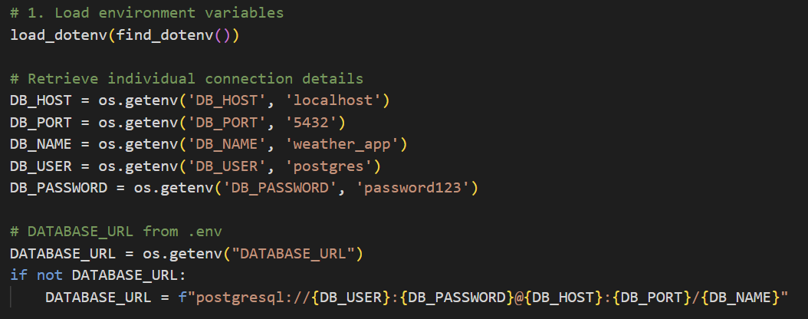
Backend
Intro
Methodology
Architecture
Demo
Challenges and Improvements
database.py
weather_api.py

Slide 10
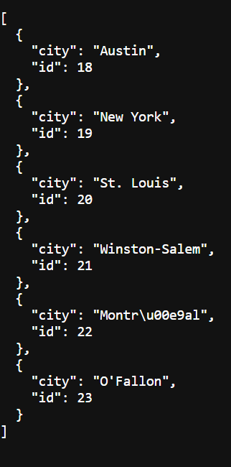
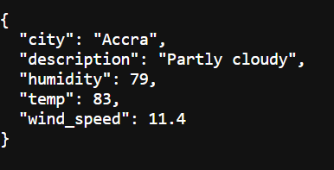
PostgreSQL
Intro
Methodology
Architecture
Demo
Challenges and Improvements
What we intended for it
Connecting both PostgreSQL and WeatherAPI.com
Adds what city or zip code we searched into a database
Compare weather (In-progress)

Slide 11
03
Demo

Slide 12
04
Challenges and Improvements

Slide 13



Challenges
Intro
Methodology
Architecture
Demo
Challenges and Improvements
Getting started
Connecting database/importing data
Error handling
Connecting frontend to backend (export .jsx)
Frontend
Redis (Wasn’t implemented)

Slide 14
Improvements
Intro
Methodology
Architecture
Demo
Challenges and Improvements
Better visuals
Better to-do functions
Fahrenheit to Celsius
Deployment

Slide 15
Thank You to
Gemini 2.5 Flash
https://react.dev/learn/writing-markup-with-jsx
https://www.w3schools.com/postgresql/postgresql_pgadmin4.php
https://www.weatherapi.com/

Slide 16
Q&A

